Slide 1
2019 Older Youth Retreat Staff Training Session

Slide 2
Purpose:
Provide an overview of the youth retreat
Review expectations for youth and staff
Selecting the appropriate youth to attend
Concept of community/shared supervision
Love and war
Emergency information
Registration overview
Provide staff an opportunity to ask questions
Notes:
Provide an overview of the youth retreat
Review expectations for youth and staff
Talk about the importance of selecting the appropriate youth to attend
Review concept of community/shared supervision
Address Love and war
Share Emergency information
Provide an overview of registration
Provide staff an opportunity to ask questions

Slide 3
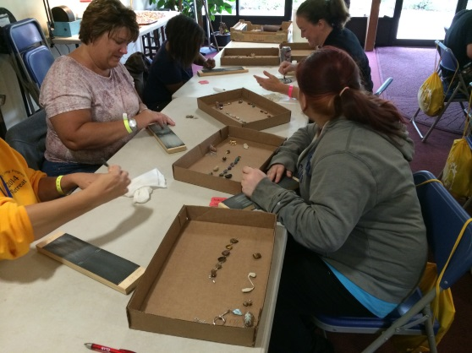
Overview:
University of Pittsburgh, Johnstown (UPJ)
August 5-9, 2019
Theme: “You’re not dreaming if you’re only surviving”
Expect approximately 100 youth and 50 staff
Planned by the Older Youth Retreat Steering Committee
Funded by the Department of Human Services, Office of Children, Youth and Families
Coordinated by the PA Child Welfare Resource Center
Notes:
University of Pittsburgh, Johnstown (UPJ)
August 5-9, 2019
Theme: You’re not dreaming if you’re only surviving
Expect approximately 100 youth and over 50 staff from county and provider agencies
Planned by the Older Youth Retreat Steering Committee – including youth, county and private providers of IL services, statewide partners, and CWRC staff
Funded by the Department of Human Services, Office of Children, Youth and Families
Coordinated by the PA Child Welfare Resource Center

Slide 4
Youth Retreat Week: Schedule – most important document for the week
Monday:
Basketball Tournament
Board Games
Pool
Dodgeball tournament
Tuesday:
Dance
Movie
Wednesday:
Volleyball tournament
Staff Training
Focus Groups
Thursday:
Retreat games
Activity presentations
Banquet
Talent Show
Friday:
Closing Ceremony
Dorm cleanup
Departure
Notes:
1. Handout #1 Schedule-Most important document for the week (please be aware when youth and staff attendance is required – Green=youth only attendance required, blue=youth and staff attendance required). In general, staff is strongly encouraged to attend all events. The only exception would be peer group sessions (youth only).
Peer Group and Activity sessions
Again this year, in order for a youth to change an activity they will need to obtain an activity swap form from CWRC staff. Facilitators will be instructed not to allow youth into a session w/o this form. Important to allow youth to review activity descriptions (revised this year and new activities have been added) and chose their own activity. If a youth wants to change activities, both the youth and their staff member must come to the desk outside of Cambria. We are asking that all youth attend the first activity session on Monday before making this type of request.
Dorm Room Sharing (Youth and Staff)
Youth under the age of 18 will NOT be able to share a room with a young adult 18 or older – there are no exceptions. You will notice that during registration this year we will ask for DOB – that is so that we can ensure this process is followed.
To alleviate an influx of youth requesting dorm room changes, we ask again that during registration you allow youth to pick a roommate. Room changes will only be evaluated on a case by case basis by CWRC staff. Any youth requesting a room change will need to have a staff member with them at the time of their request. Under no circumstances should any youth or staff switch rooms without informing CWRC staff. We must be able to report to the university who is in each room in case of emergency.
New this year, we will send dorm room assignments out with confirmation emails so staff can make any possible changes prior to the retreat
This year we have new name tags that will attach to a lanyard which you can also put your key and meal card. The goal is to help us better identify youth v. staff as well as be aware of people’s pronouns.
Agency responsible for dorm keys – fee charged for lost keys is $60. Please alert CWRC staff if a key is lost immediately.
Meals (plenty of snacks, there are fridges and microwaves in dorms)
Wrap-Up – check in w/ youth
Free Time – less this year, more structured week.
Review schedule: (This year all games/tournaments will be held at the Fitness Center – all youth and staff in one building.
Monday – Basketball tournament, dodgeball tournament, board games, pool open
Tuesday – Dance, Movie
Wednesday – Volleyball tournament, staff training, focus groups
Thursday – very busy: retreat games, activity presentations that highlight work throughout the week, banquet, talent show
Friday - recognize youth and their participation throughout the week at the closing ceremony, check out
2. Handout #2 Peer Group Session (less this year)
Smaller group sessions, youth led, supported by adult co-facilitator, follow youth developed curriculum (any issues – please let CWRC staff know immediately).
3. Handout #3:Activity Descriptions
Highlight new activities this year
Importance of allowing youth to select their own activities (let them review this document)
Staff maintain supportive role in activities

Slide 5
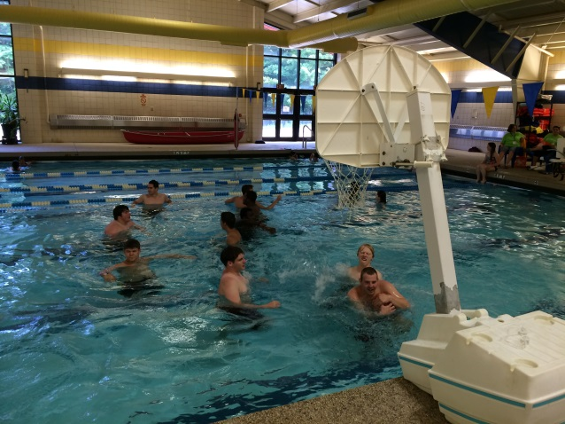
Dress for the Week:
Dress casual
Athletic shorts, jeans, sweatshirts etc.
Pool attire
If wearing a two piece bathing suit, females must wear a colored t-shirt over their suit.
Dance
Jeans, dresses, formal wear (not required)
Banquet
Business attire, sun dresses, dress pants, tie
Notes:
Critical for females to have appropriate clothing
Be aware of the length and fit of dress, shorts, skirts
Important for staff to be present and move around at dance (increased crowd control suggested by youth)
Banquet – stakeholders in attendance.
While there is no formal retreat dress code, we ask that staff have the conversation with youth before and during the retreat about what is appropriate attire.

Slide 6
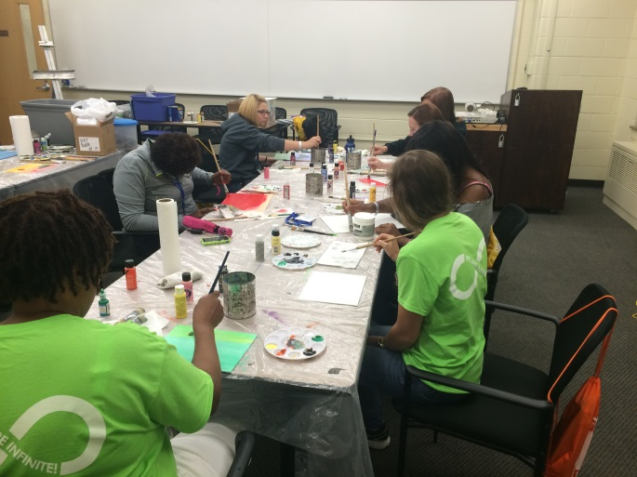
Older Youth Expectations:
Safety first
Follow your schedule
Attend all peer group and activity sessions
Respect the concept of communal living while on campus.
Participate
The retreat is not a vacation!
Notes:
Handout 4 – Youth expectations
Safety first – relates to everything - physical safety, emotional safety – no drugs, no weapons
Variety of different ages and life experiences. Youth may also be sharing emotionally vulnerable experiences (important to check in with youth).
Attend all sessions – this is supposed to be like the college experience, follow your schedule
Community – think before you act, we are not the only group on campus – be respectful (language etc.)

Slide 7
Youth expectations (cont.):
Set expectations PRIOR to arriving on campus
Youth should be respectful of themselves and others
Appropriate vs. inappropriate interactions w/ other youth
Dance – reasonable guidelines for dancing space
Defuse potential hostile situations
Important to check in with youth during wrap up
Notes:
Set expectations BEFORE arriving at UPJ
Let your youth/alumni know what is appropriate behavior and what is not
Youth should be mindful and respectful of themselves and others at all times
You’ll notice: Monday – shy, Tuesday – building relationships, Wednesday – like each other/relationships have formed
Appropriate vs. inappropriate interactions
Holding hands, hugs = okay
Kissing, making out, fondling = not okay
The Dance
Use reasonable guidance about appropriate dancing- “I’m not sure how to describe it but I know what it looks like when I see it”
Defuse potential hostile situations…
Know your youth/alumni – know their triggers and discuss how things are going with them throughout the week – take some time to talk to them and give them positive attention if they need it

Slide 8
Youth Will Be Sent Home For:
The following are immediate grounds to be sent home:
Fighting
Drugs/alcohol
Weapons
*These are not the only reasons youth will be sent home. Situations will be evaluated on a case by case basis.
If youth are sent home:
Youth must be supervised by agency staff until they exit campus.
Important to have back-up staff on standby or all other youth from that county will need to go home as well.
Notes:
Zero tolerance for drug possession, use or suspected use.
We do not search rooms or bags. You are responsible for your youth.

Slide 9
Staff Expectations:
Supervision
You are responsible for your youth at all times
On call 24 hours a day at retreat
Important to keep phone on
Provide accurate cell number during registration
Shared supervision
Reduce opportunities for triangulation
Coverage throughout the week for special events
Wrap Up
Notes:
Handout 5: Staff Expectations
Handout 6: Coverage/Volunteering (use when selecting coverage during registration) – please keep with you throughout the week so you know what is expected of staff at each event (will be included in your folder at registration on campus)
Step through
Reviewed on campus as well
Handout 7: Wrap Up-discussed in more detail later which is more than checking in during meals.
On-call 24/7 – keep phones on (make sure you register with the cell # you’ll be using during the retreat week), sign-in and sign-out to leave campus – night monitors will come get you if something happens
Shared supervision – if you see something, say something (to youth, to staff, or CWRC staff)
Coverage throughout the week includes volunteering special events as well as participating in activities. In activity sessions you are there to support the facilitators and help youth.
This is NOT a typical work week – long days. (Work out with your employer – CWRC does not get involved)
When addressing youth we ask that you always use a strengths based approach.
Please note, it is important to bring issues to the attention of CWRC staff so they can be appropriately addressed and documented. In these cases, you may not receive the outcome of the issue, but please know it is being addressed. We take any concerns/issues during the retreat week extremely serious in an effort to keep everyone safe.

Slide 10
Staff Expectations (continued):
Increased county/provider staff support in managing youth.
Dorm coverage
Ensuring youth attendance at all required events
Notes:
In years past the staff of the CWRC and the retreat steering committee have provided “grounds coverage.” Staff were assigned different shifts to walk the campus to be sure youth were where they were expected to be. This year our staff will not be formally providing this coverage. It is expected that county/provider staff will be monitoring the campus and their youth at all times.
Dorm Coverage
Be a support in the dorm if needed.
Be aware of where items are located including first aid kits, sign out sheet etc.
Ensure that males are in the male dorm, females in the female dorm.
Ensure that youth are not “hanging out” in the dorm when they should be at their assigned classroom/activity sessions.
Grounds Coverage
Goal is to prevent things from happening, not to “catch” individuals in the act.
If you do encounter a situation, diffuse the situation if you feel comfortable to do so, or contact the Retreat Steering Committee or other staff nearby for additional support. We ask that you utilize your own judgment.
We recommend that you walk with a partner and have a flashlight with you in the evening.
With regard to youth attendance at peer group and activity sessions, it will be the county staff/provider’s responsibility to check in and make sure youth are attending their sessions. CWRC staff will receive attendance sheets daily at our desk outside of Cambria and can provide them to you at your request. You will be contacted via cell phone if your youth doesn’t attend a session. This is why it is extremely important to let CWRC staff know if a youth has your permission to be in their dorm/not at an activity.
As always, the retreat is meant to be a structured, enjoyable week for both youth and staff. In general, we expect that staff is responsible for the youth they bring, but also expect shared supervision on the campus. Because we are living on the campus, you are on-call 24hours a day as it relates to the youth you bring. Please be sure your cell phone is turned on and with you at all times.

Slide 11
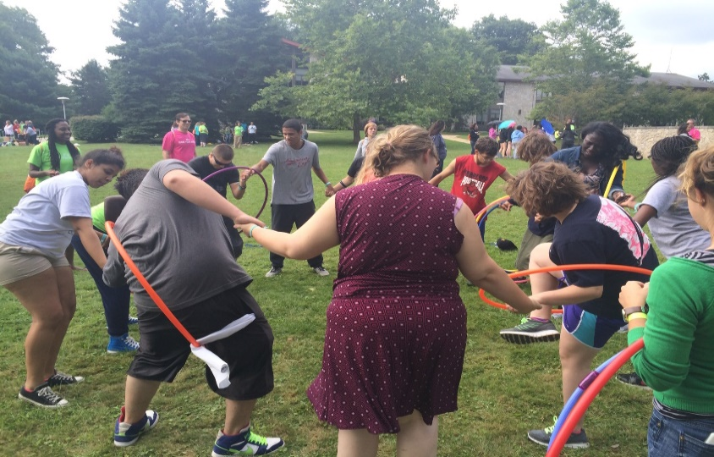
Choosing Appropriate Youth:
Know your youth
Have an established relationship
Behavior and attitude
Level of interest
Restrictive nature of the retreat
Notes:
Know your youth/alumni
This is a long week, the more you know about the youth you are brining and their triggers etc., the more it will help you supervise that youth and ensure they get the most out of the retreat
Please take into consideration your youth’s history and evaluate their ability to interact with other youth and live communally. We don’t ever want youth to be put in compromising situations (for themselves or others). We have no history on the youth who register – that is why it is important that you make informed decisions on which youth to register.
Good relationship
Helps with supervision
Attitude and Behavior
This is a grueling week – youth are up early and active all day – maintain a positive attitude, model positive behavior for youth.
Interest
Probably the most important factor – does the youth actually want to attend? Does the youth want to attend for the right reasons? This is not a vacation!
Alumni and the restrictive nature of the retreat
Some alumni (and other youth in less restrictive placement settings) may not be used to having a bed time or having to follow a schedule. Because the retreat has youth of varied ages, maturity levels, developmental levels it may seem restrictive. Be sure all youth /alumni understand what the expectations are.
Youth who are 19/20 may not want to adhere to a curfew
Characteristics of appropriate youth:
Mature
Respectful
Open minded
Punctual
Non judgmental
Compassionate
Friendly
Positive attitude
Willing to participate
Sympathetic
Wants to be there
Courteous
Patient
Role model/leader

Slide 12
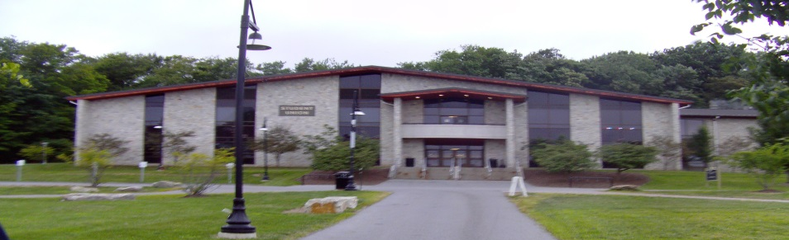
Community and Shared Supervision:
We are all responsible for each other.
If you see something, say something.
Role modeling positive behavior
Effectively intervening with youth
Strength based, solution focused
Notes:
We are all responsible for each other
Staff and youth alike – if you see one of your colleagues “losing it” have a talk with him or her
Check in with your youth/alumni throughout the day
In general, “If you see something, say something.”
Youth/alumni will push boundaries during the retreat. The boundaries are there to keep us all safe. If you see youth behaving inappropriately, hear youth using profanity, see bullying, etc. find the best way to intervene and acknowledge that the youth/alumni has “crossed the line”
Role Modeling Positive values and behavior
If you’re miserable, skipping activities, and complaining all week how will your youth react? Important to set a good example and maintain a positive attitude
Effectively Intervening with youth/alumni
This is best done by the staff person that knows the youth best
If this is not possible, pulling the youth aside and talking to him or her individually
Using “I” statements as much as possible
Using humor, not confrontation
Always use strength-based, and solution-focused approaches

Slide 13
Youth Retreat Supervision:
Once wrap up concludes:
Staff escort females/males to their dorm buildings
Dorm socialization in lobby of dorm/smoking area outside of the dorm until 11:00pm
Must be in your own dorm room at 11:00pm
Quiet hours are from 11:00pm – 7:00am
Notes:
In the past there has been some “gray areas” with the transition time. Please follow these standards.
Reminder that CWRC staff will not be escorting youth back to the dorms. It is the responsibility of staff to ensure all youth return to their dorm.
Males and females always to be in separate dorms – no exceptions

Slide 14
Emergency Procedures:
Nurse on campus at high activity times
When in doubt, dial 911
Staff are responsible for administering and holding medications as necessary for your youth
Staff must also accompany youth requesting medication or treatment from the nurse or any CWRC staff.
List special needs accommodations during registration (i.e. dietary restrictions, food allergies, etc.)
Back-up staff (hospital visit)
Fire safety procedures – Do not ignore an alarm!
Directions to hospital and emergency numbers will be provided upon registration on Monday.
Notes:
Handout 8: Safety (more detail received in folder upon registration at retreat)
Note importance of correctly filling out health information form
Nurse schedule will be posted – during tournament, high activity times, each morning between 8am – 10am
If nurse is not on campus, visit the desk outside of the Cambria Room

Slide 15
Online Registration Process:
Registration information and agency slot allocations will be emailed in May to county identified IL Coordinators.
All staff attending the retreat will need to provide copies of their FBI, Criminal Background, and Child Abuse Clearances. In accordance with the law, these must be dated within 5 years of 8/10/19.
All registration information is due July 5, 2019. This is a firm deadline, no new registrations will be accepted after this date.
Agencies are encouraged to submit registration for waiting list youth and staff.
We can no longer accommodate last minute swaps. All same sex swaps from the youth waiting list with completed paperwork are due July 31, 2019.
All registration must be submitted through the online registration. No exceptions.
Notes:
Meghan:
This year our registration deadline of July 5, 2019 is firm. After this date we will not accept new registration/paperwork. All youth and staff, attending or waiting list, must be entered into the online system by July 5th. It is important that we get accurate information to the campus in a timely manner so they can prepare for our arrival. We will accept same sex swaps until July 31, 2019 (these are youth from the waiting list who were registered in the survey monkey by July 5th and have completed paperwork). Under no circumstances are staff to bring youth to the retreat that have not been registered through the online process. Staff are also not to switch a youth after July 31st in the case that another registered youth can’t attend. You will receive a confirmation email with all registered youth – if youth are not on that list, they are not registered and therefore unable to attend the retreat. Any unregistered youth will be sent home.
Please note we are generally able to accommodate all waiting list youth prior to the 31st .
There is no longer an option to submit the paperwork online directly from registration. All paperwork will need to be completed and then scanned and emailed/faxed/etc.
Clearances – all staff must submit copies of their clearances with their registration paperwork. New this year: the University has a 3rd party vendor who will be tracking clearances, reaching out to you for missing clearances and ensuring that they are up to date. The system is ProVerify. If you receive an email from them it is on behalf of the University and we ask that you proceed with the instructions they provide you. If you have any questions related to clearances please contact Lisa Kessler or Meghan O’Hare.
Also, this year our registration will ask about accommodations needed for the week. This is in an effort to help us ensure everyone is able to fully participate in the event. An example would be if you have a youth who is deaf or hard of hearing attending. It is important for our staff to be aware of that in the case we have to interact with that youth directly. This is not an opportunity to ask for air conditioning, better dorm rooms, etc.
Other things to consider: if you have a transgender youth, please contact Lisa or Meghan so we can make the appropriate dorm room accommodations.
We have a new online system this year which Lisa will explain.
Lisa talks

Slide 16
Online Registration Components
Includes same participant information as previous years.
Staff completing the registration will need ALL participant information in order to proceed.
After completing online registration you will need to mail, fax, or email all signed releases by July 5th, 2019.
Notes:
Again, it is extremely importance that your releases and clearances are submitted by the registration deadline to confirm your registration.
Very important to let youth chose activity and roommate – avoids issues with switching once youth arrive on campus. Reminder, no youth under age 18 to room with a youth/young adult 18 or older.

Slide 17
Registration FAQ:
May I have extra slots?
Am I allowed to “swap” youth?
What should my youth and I pack?
Are youth able to change activity sessions during the week?
Are youth able to change roommates?
What releases are required?
Authorization to participate
Health information
Multimedia
Contact Meghan O’Hare with any additional questions:
meo43@pitt.edu or 717-605-0230
Notes:
Handout 10– What to Bring
Slots based on AFCARS, utilize waiting list
Release – multimedia release won’t stop attendance at retreat.

Slide 18
Retreat Video:
The youth retreat video from 2018 can be found on the YAB website at:
http://www.payab.pitt.edu/ILRetreat.htm
(scroll to 2018 retreat)
Notes:
Staff and Youth videos on YAB website
Educate both staff and youth.

Slide 19
In closing….
Veterans’ words of advice
Participation on Retreat Steering Committee
Reminders
Questions
Notes:
Handout 11 – Youth veteran’s words of advice
Handout 12- Staff Veteran Words of Advice
Handout 13- Retreat Talk
Indicate interest in joining steering committee on evaluation forms at retreat or outreach to Meghan O’Hare during/after the retreat. This group forms in September each year and begins meeting in December.
Reminder – county/provider staff are not permitted to invite guests to the campus during the youth retreat

